Slide 1
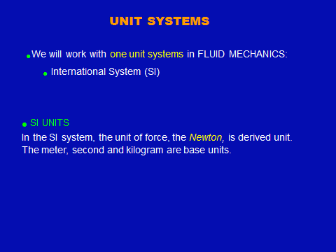
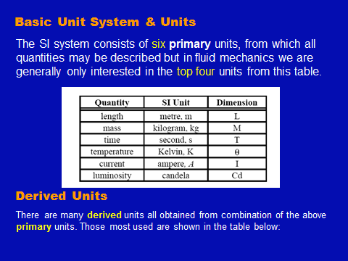
Fluid Mechanics Class Note
Dr. Qassem Hamed Jalut Associate Professor
DIMENSIONS AND UNITS

Slide 2
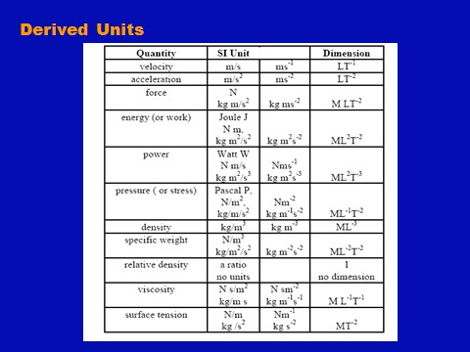
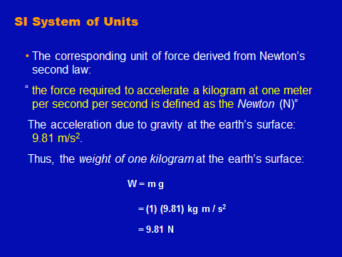
Fluid Mechanics Class Note
Dr. Qassem Hamed Jalut Associate Professor

Slide 3
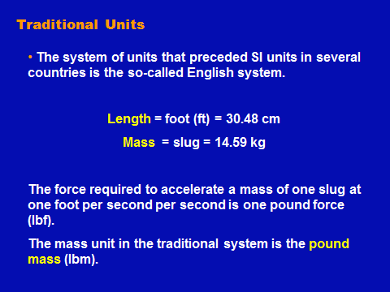
Fluid Mechanics Class Note
Dr. Qassem Hamed Jalut Associate Professor
Main units are: Length (L), Mass (M), and Time (T). Most of the other quantities like force, pressure, power, and more can be derived from the main three quantities: LMT.
In fluid mechanics, there are only four primary dimensions from which all the dimensions can be derived: mass, length, time, and force. The brackets around a symbol like [M] mean “the dimension” of mass. All other variables in fluid mechanics can be expressed in terms of [M], [L], [T], and [F].
For example, acceleration has the dimensions [LT-2]. Force [F]
is directly related to mass, length, and time by Newton’s second law,
Force= Mass x Acceleration
F = m a
From this we see that, dimensionally, [F] = [MLT-2]. 1 kg-force = 9.81 Newton of force = 9.81 N

Slide 4
Fluid Mechanics Class Note
Dr. Qassem Hamed Jalut Associate Professor
Table (1) Primary Dimensions in Fluid Mechanics in the International System of Units (SI)
Dimension
Unit
Length (L)
meter (m)
Mass (M)
kilogram (kg)
Time (T)
second (s)
Force (F)
Newton (N) = kg.m/s2) = MLT-2
Temperature (θ)
Kelvin K º
Celsius C º
K=Cº + 273º
Table (2) Secondary Dimensions in Fluid Mechanics in the International System of Units (SI)
Area [L2]
m2
Volume [L3]
m3
Velocity [LT-1]
m/sec
Acceleration [LT-2]
m/sec2
Pressure or stress [FL-2]
Pa= N/m2(Pascal)
Angular Velocity
sec-1
Energy, work [FL] J = Nm (Joule)
Power [FLT-1] W = J/sec (Watt)
Specific mass (ρ) [ML-3] kg/m3
Table (3) Commonly used prefixes for SI units:
10

Slide 5
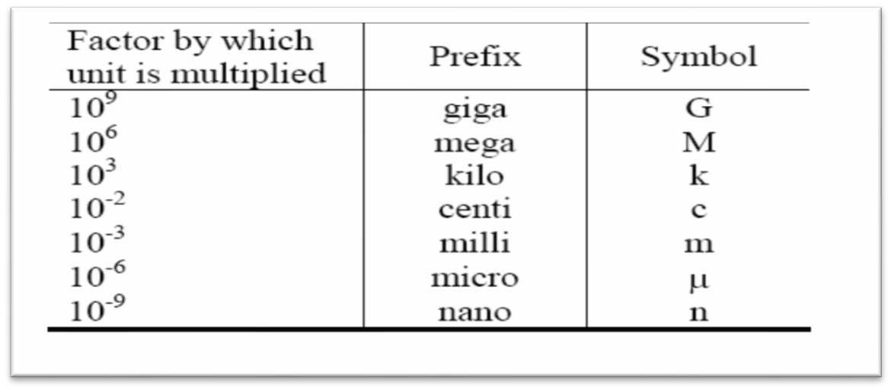
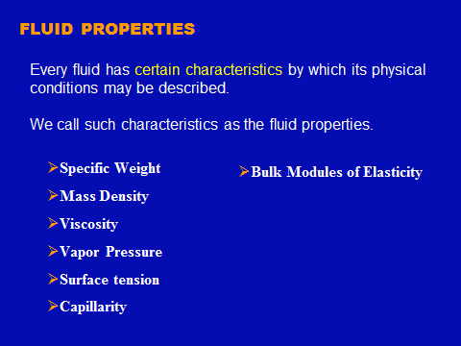
Fluid Mechanics Class Note
Dr. Qassem Hamed Jalut Associate Professor
Fluid Properties

Slide 6
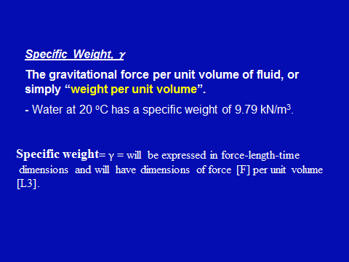
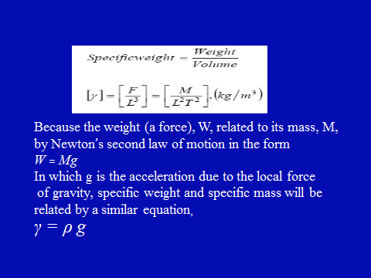
Fluid Mechanics Class Note
Dr. Qassem Hamed Jalut Associate Professor

